Slide 1
City Genres
Members
Chin-Hsuan Chen, Jintong Yu, Kexin Chen, Matthew McMurry, Peizhi Zhang, Yiming Wang
Coordinator
Priceline

Slide 2
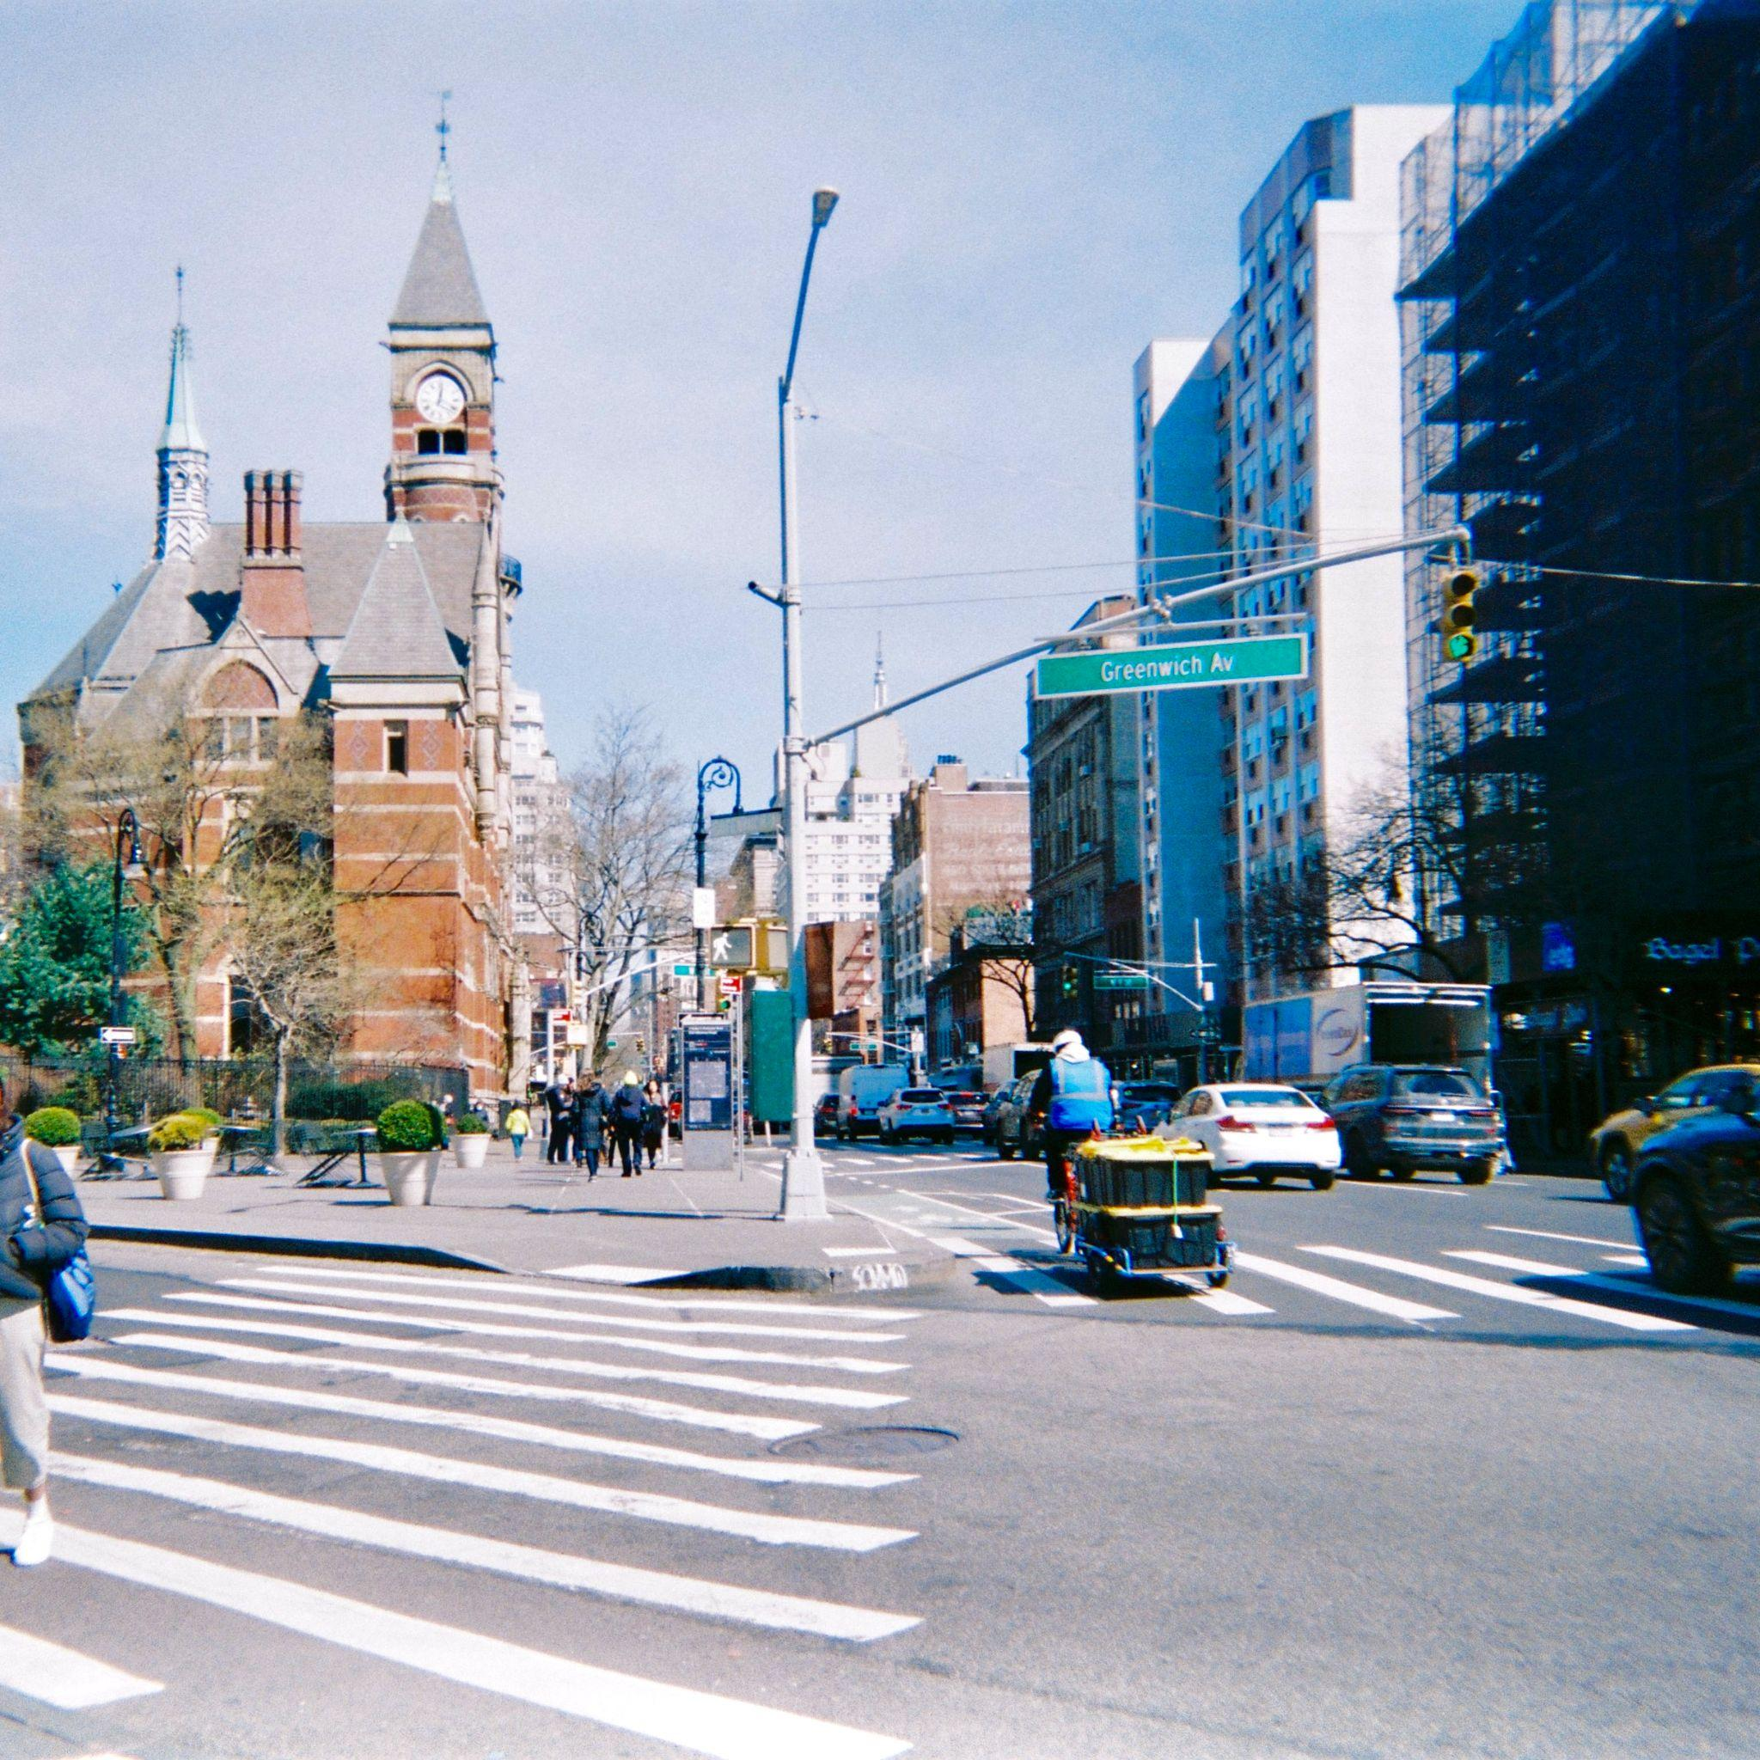
Catalog
Introduction
Data Collection
Data Cleaning
Exploratory Data Analysis
Methods and Results
Move forward…
Appendix

Slide 3
Introduction
Identify what makes two cities similar from a traveler’s perspective, find data to build your case, create features from diverse website data to help you build a clustering model, deliver the “genre” for each city, along with key artifacts.
Introduce the problem
When users search for tourist cities they want to visit, it's challenging to discover other similar cities that they might enjoy
The need for a recommendation system
Help users find new, exciting destinations based on destinations’ similarities
Address the reasons for choosing this problem statement:
High demand for personalized travel experiences
Increase customer retention and conversion rates
Enhance Priceline's competitive advantage
Potential benefits for stakeholders and the target audience:
Improved user experience, increased customer satisfaction, and higher conversion rates.

Slide 4
Data Collection
Step 1: Determine Quality Data Sources
Ensure we have sufficient data
Make sure the data is wide-ranging and comprehensive
Step 2: Determine Methods and Collection Procedures
To standardize collection, 3 groups of 2 were formed for each of 3 data sources
Data Sources: TripAdvisor, Wikipedia, and Google Search
Variety of Methods Used, Depending on Source
TripAdvisor
Methods: Web Scraping HTML with BeautifulSoup
Data Collected: “About Cities”, Paragraphs
Wikipedia
Methods: Web Scraping HTML with BeautifulSoup
Data Collected: Main Body of Page
Google Search
Data Collected via custom scripts
Data Collected: "int_visitor_2019 (million)", "Dec-Feb Avg Temp (°F)", "Jun-Aug Avg Temp (°F)", "mountain","beach","island","lake","forest","river","desert","sea sports","old town", etc.

Slide 5
Data Cleaning
Step 1: Export .txt files from scraped urls and combine .txt into one .csv file
Step 2: Preprocess the text file using stop words, lemmatization, lower case, remove punctuation, strip white space
Package used: nltk (Natural Language Toolkit)
Step 3: Further data cleaning through manually cleaning missing, irrelevant data
Remove more new stop words
Take care of missing values
TripAdvisor
Some cities’ “about” pages do not exist, which explains the N/A values
Wikipedia
Missing information due to different url strings from the original for-loop code
Revised url strings to obtain missing values
Google Search
Ran lambda functions on each row of dataframe multiple times to create new columns
Used keyword extraction to output both categorical data (Y/N) and string/integer data (temperatures/visitor numbers etc.)
Manually input N/A values by going back to the google search website and searching for the values

Slide 6
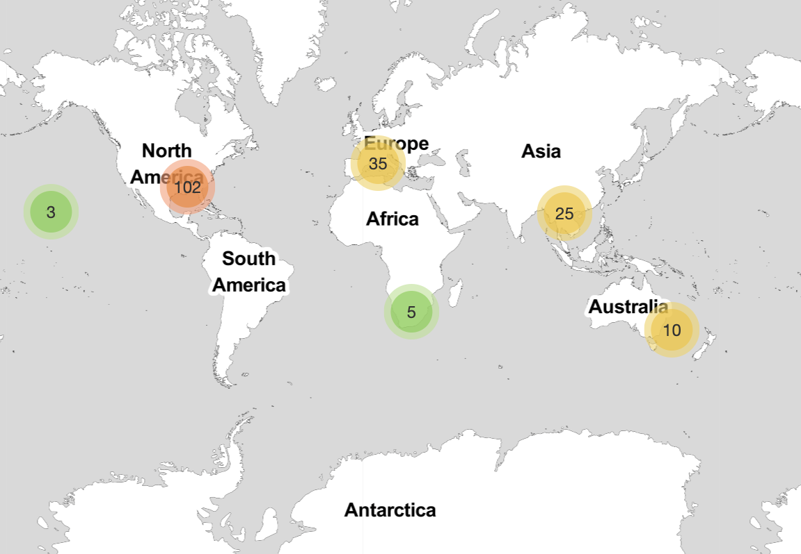
Exploratory Data Analysis - World Map

Slide 7
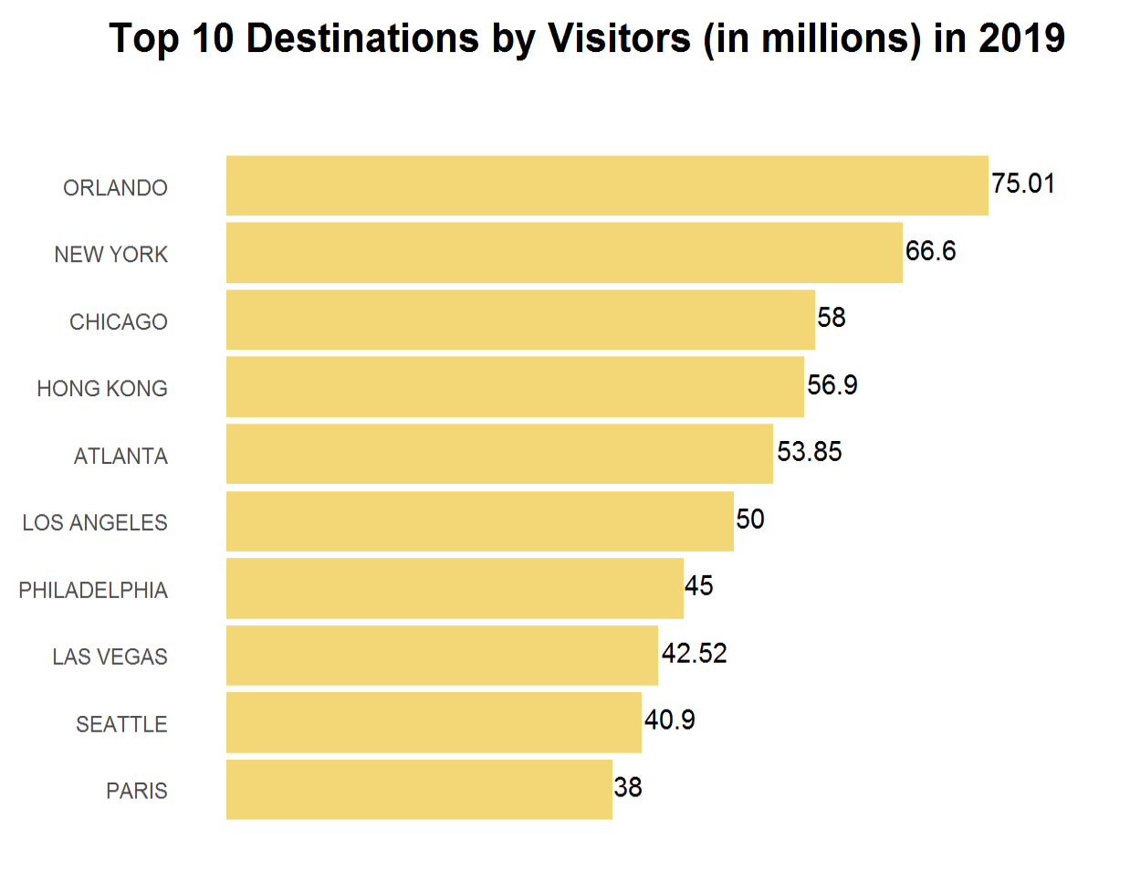
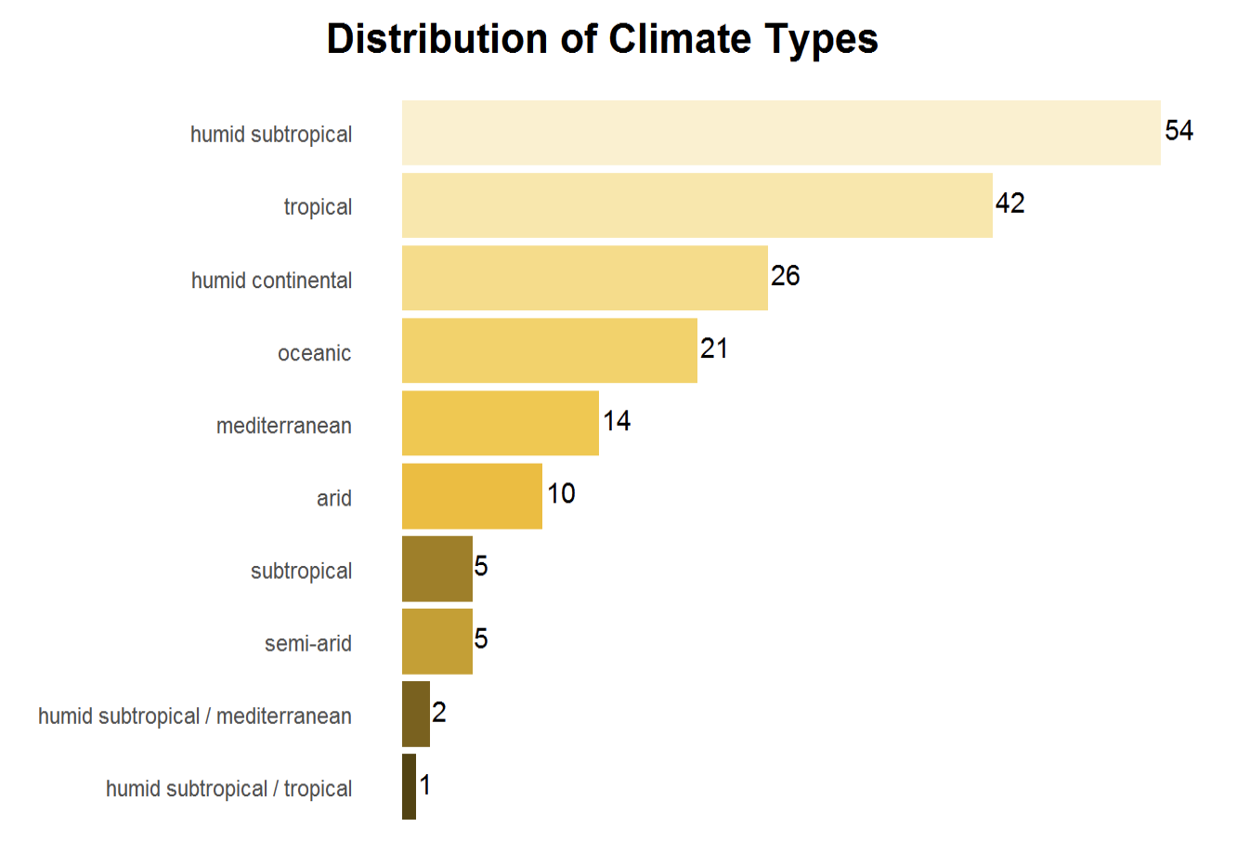
Exploratory Data Analysis - Key Patterns

Slide 8
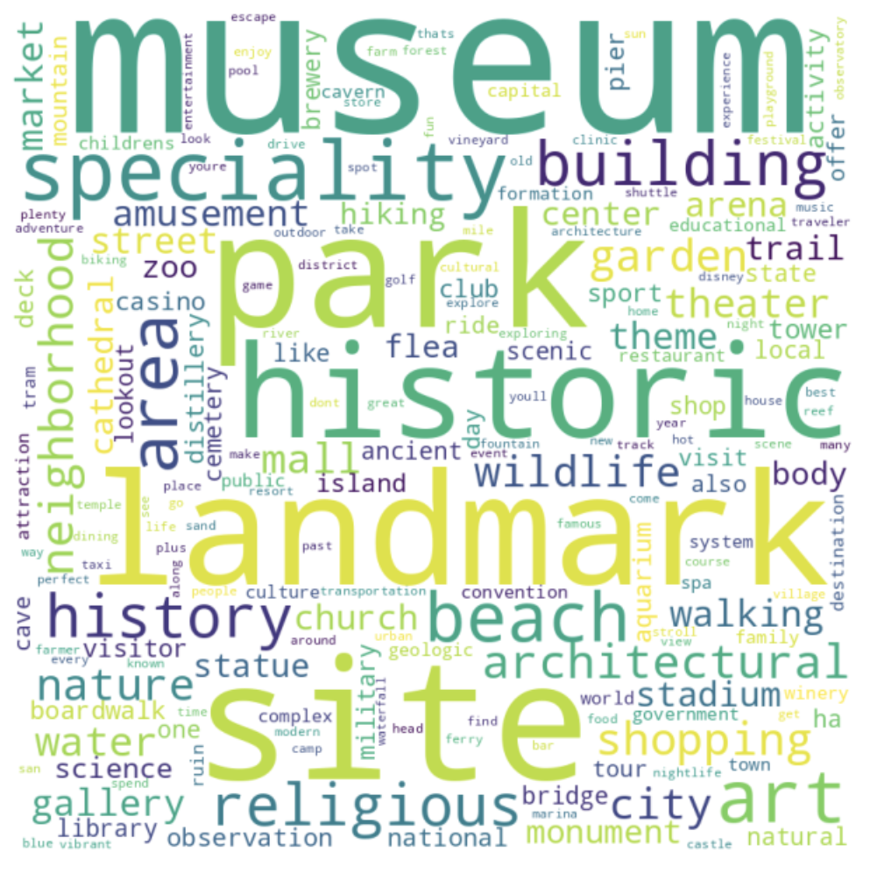
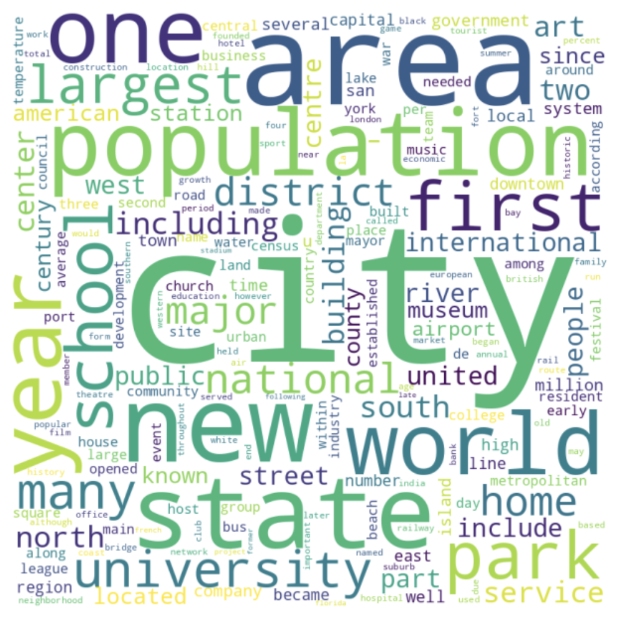
Exploratory Data Analysis - Word Cloud
[TripAdvisor]
[Wikipedia]

Slide 9
Models
Latent Dirichlet Allocation (LDA)
DBSCAN
Hierarchical Clustering (numeric features)
BERTopic
(Wikipedia & Double-Pass)
Feature Engineering
Word2Vec
BERTopic (all text)
K-Means

Slide 10
Final Model: BERTopic
Two Different BERTopic Approaches
Single-Pass Approach
Topic Modeling on Paragraph Column of Entire DataFrame
Mixed Results
Coherent Topics (Good), Mostly Grouped by Geography (Bad)
Double-Pass Approach
First-Pass: Broad Modeling to Create Main Groups (5 Groups)
Second-Pass: Topic Modeling on Each Main Group to create Subgroups
Improved Results
19 Clusters Overall
Mix of Geographies, Cities Grouped Coherently

Slide 11
Final Genres
Museum and Landmark Enthusiasts
Amusement and Theme Park Enthusiasts
Historic and Architectural Explorers
Beach and Park Lovers
Shopping and Art Admirers
Cultural and Walking Tour Enthusiasts
Heritage and Landmark Enthusiasts
Art and Garden Enthusiasts
Landmark and Cathedral Explorers
Museum and Arena Visitors
Park and Activity Enthusiasts
Cultural and Religious Landmark Explorers
Nature and Art Enthusiasts
Architectural and Market Discoverers
Monument and Status Admirers
Historical Park and Shopping Enthusiasts
Theme Park and Garden Lovers
Beach and Nature Retreat Seekers
Waterfront and Art Admirers
(Detailed descriptions in Appendix)

Slide 12
Moving forward…
Define attributes of destinations based on traveler’s perception by conducting an online survey and collect more relevant data
Refine the quality of data to ensure that values of features are accurate and up-to-date
Experiment with different models and parameters to identify the most effective models and optimize recommendations

Slide 13
Appendix

Slide 14
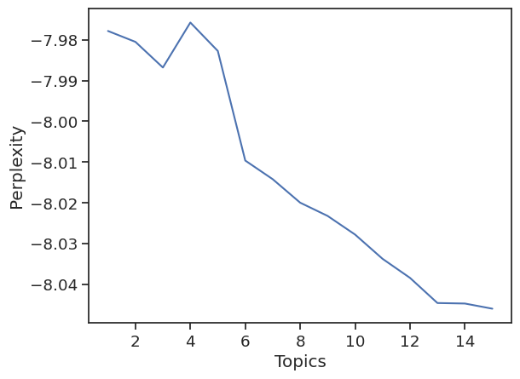
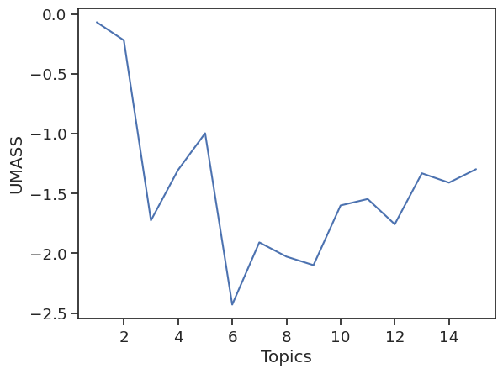
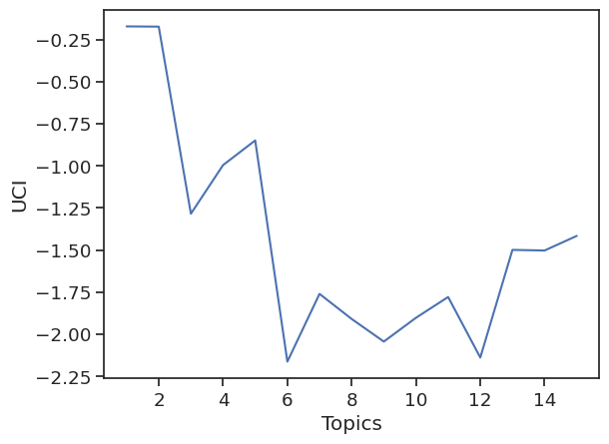
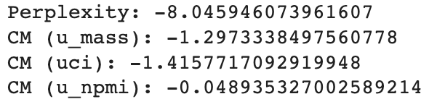
LDA

Slide 15
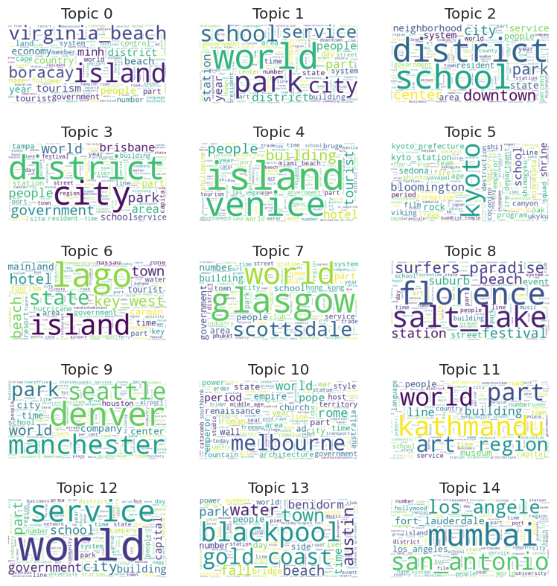
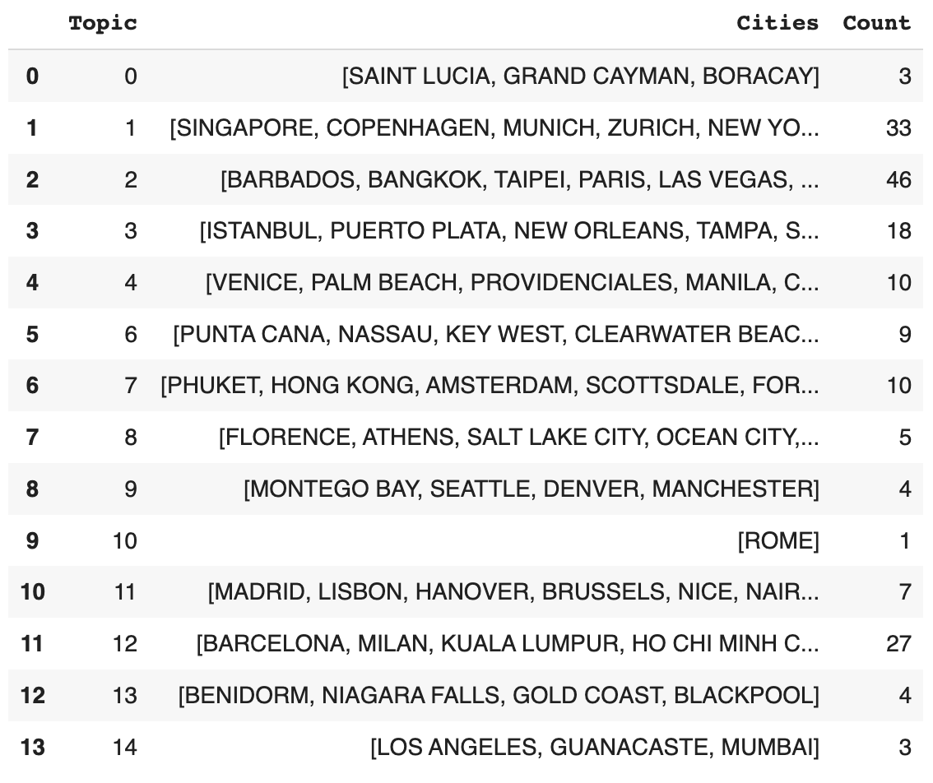
LDA

Slide 16
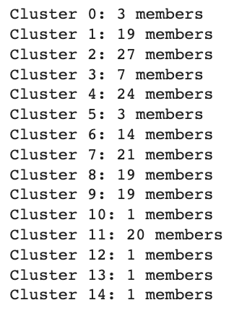
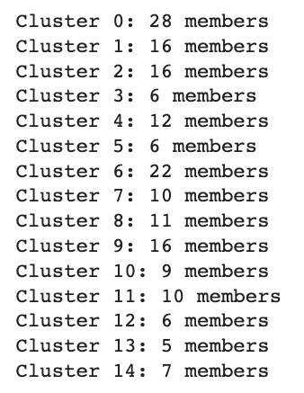
Hierarchical Clustering
Trial 1: Feature Engineering
Trial 2: Numeric Variables Only
Convert all data to numeric matrices:
-> Scale continuous variables
-> Binary categorical variables no change
-> Vectorized text data with each number representing the frequency of a term
An ensemble model:
-> Hierarchical clustering on all numeric variables (continuous & binary)
-> BERTopic on text data
-> Combine these 2 clustering results
Reason for Not Considering:
Some of clusters have only one member
Reason for Not Considering:
Clustering result is more evenly distributed but based on numeric variables only
The silhouette score is low for the combination → not a good clustering result

Slide 17
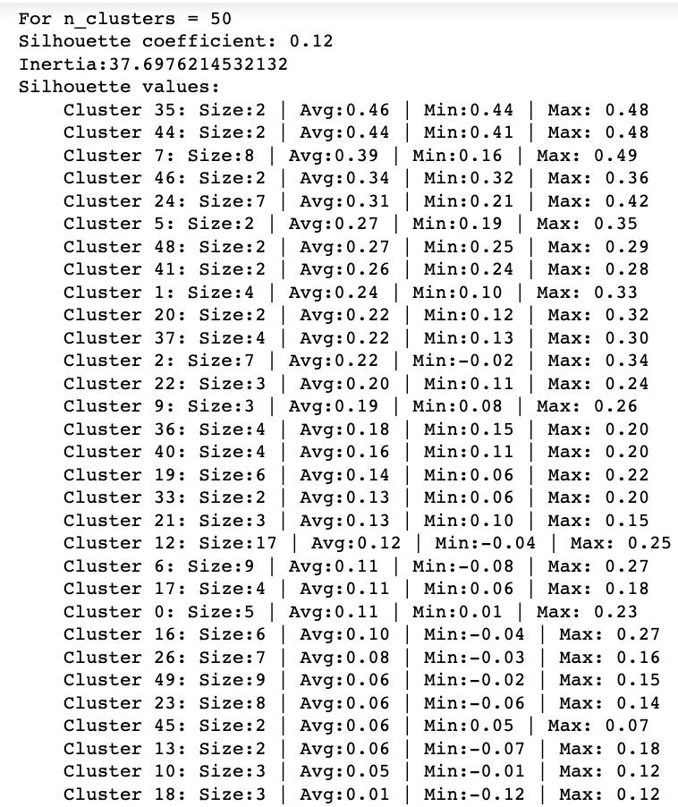
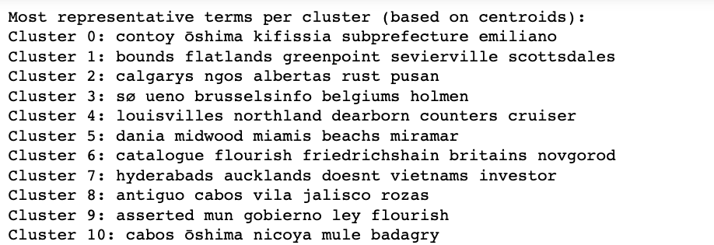
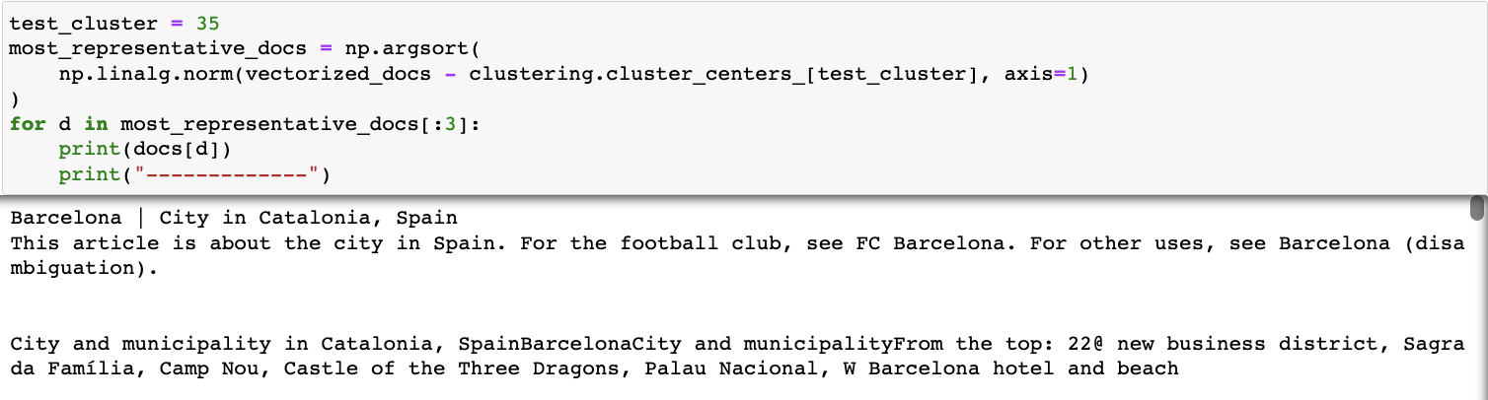
Word2Vec and K-Means
Output of Cluster Algorithm
2. Qualitative Review of Clusters

Slide 18
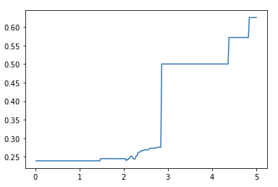
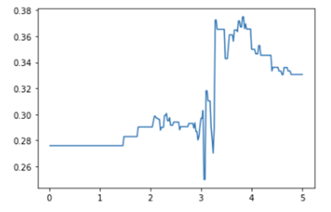
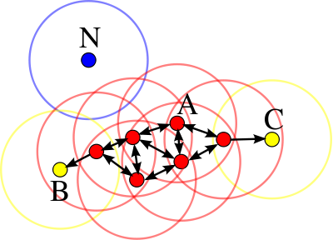
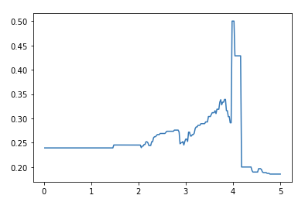
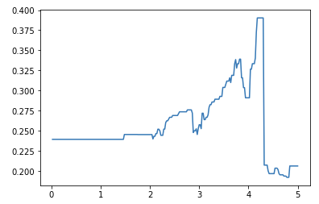
DBSCAN
Density-based clustering method.
It sets up the distance in the clusters from points to points to develop clustering.
X-axis: Distance
Y-axis: Accuracy
Notes:
We have used two unsupervised ML methods to develop clustering, which was to find out certain insights from clustering methods as well as examine the fitness of two unsupervised ML methods in the process.
DBSCAN and K-means clustering methods were used for the analyses. Both of the methods are commonly used for clustering.
Threshold: The number of visitors annually (3.13, 7.5, 16.2, more than 16.2)

Slide 19
Final BERTopic Results
Cluster Group 0-0: ALBUQUERQUE, AUCKLAND, BRISBANE, CANCUN, CHRISTCHURCH, DURBAN, KEY WEST, MADRID, MANCHESTER, MIAMI, PHOENIX, TUCSON, TULUM, WELLINGTON
Cluster Group 0-1: BARBADOS, BORACAY, CAPE TOWN, GOLD COAST, LAS VEGAS, PERTH, RENO, SAINT LUCIA
Cluster Group 0-2: ATLANTIC CITY, CLEARWATER BEACH, DAYTONA BEACH, FORT LAUDERDALE, LOS ANGELES, MIAMI BEACH, NEWQUAY, OCEAN CITY, PLAYA DEL CARMEN, QUEENSTOWN, SURFERS PARADISE, VIRGINIA BEACH
Cluster Group 0-3: JACKSONVILLE, KISSIMMEE, ORLANDO, PALM BEACH, WEST PALM BEACH
Cluster Group 0-4: BENIDORM, ISTANBUL, MONTEGO BAY, PUNTA CANA, SCOTTSDALE, UNCASVILLE
Cluster Group 0-5: BLACKPOOL, CHARLESTON, GALVESTON, MYRTLE BEACH, SAN DIEGO, SAN FRANCISCO, SYDNEY, TAMPA
Cluster Group 1-0: ADDIS ABABA, ATHENS, BARCELONA, DUBLIN, EDINBURGH, FLORENCE, JOHANNESBURG, LISBON, MUNICH, PITTSBURGH, ROME, SAVANNAH, ST. AUGUSTINE, VENICE, WINDHOEK, ZURICH, NAIROBI
Cluster Group 1-1: AMSTERDAM, AUSTIN, BALTIMORE, BROOKLYN, COPENHAGEN, FORT WORTH, HANOVER, HOLLYWOOD, MINNEAPOLIS, SEATTLE, YORK
Cluster Group 1-2: LONDON, MILAN, NEW YORK, NICE, PARIS, SAINT PETERSBURG
Cluster Group 1-3: BERLIN, BIRMINGHAM, BRUGES, BRUSSELS, CHICAGO, GLASGOW, LAKE BUENA VISTA, LIVERPOOL, VIENNA
Cluster Group 1-4: ANAHEIM, ARLINGTON, BLOOMINGTON, COLUMBUS, DALLAS, HOUSTON, INDIANAPOLIS, KANSAS CITY, LOUISVILLE, MELBOURNE, OKLAHOMA CITY, SEDONA
Cluster Group 1-5: BOSTON, PHILADELPHIA, PRETORIA, SAINT LOUIS, WASHINGTON
Cluster Group 2-0: ACCRA, BANGALORE, BANGKOK, BUSAN, HO CHI MINH CITY, HYDERABAD, JAIPUR, KAPOLEI, MANILA, MOMBASA, MUMBAI, NEW DELHI, OSAKA, PUNE, SAN ANTONIO, SEOUL, SINGAPORE, TOKYO
Cluster Group 2-1: CHENNAI, CHIANG MAI, HONOLULU, KATHMANDU, KYOTO, LAGOS, LAHAINA, PHUKET, VARANASI
Cluster Group 2-2: HONG KONG, KOLKATA, KUALA LUMPUR, TAIPEI
Cluster Group 3-0: CALGARY, DENVER, EDMONTON, OTTAWA, QUEBEC CITY, SALT LAKE CITY, TORONTO, VANCOUVER, WINNIPEG, MISSISSAUGA
Cluster Group 3-1: ATLANTA, GATLINBURG, PIGEON FORGE, RALEIGH, ASHEVILLE, CHARLOTTE, NIAGARA FALLS, PORTLAND, DETROIT, MEMPHIS, MONTREAL, NASHVILLE, NEW ORLEANS
Cluster Group 4-0: CABO SAN LUCAS, GUANACASTE, LOS CABOS, PUERTO VALLARTA, RIVIERA MAYA, SAN JUAN, SARASOTA
Cluster Group 4-1: GRAND CAYMAN, ISLA MUJERES, NASSAU, PROVIDENCIALES, PUERTO MORELOS, PUERTO PLATA

Slide 20
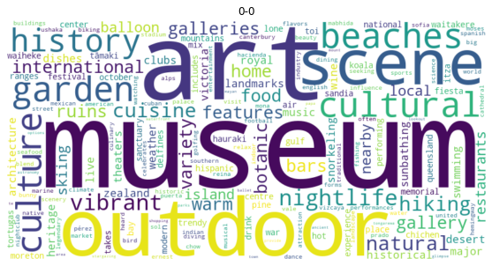
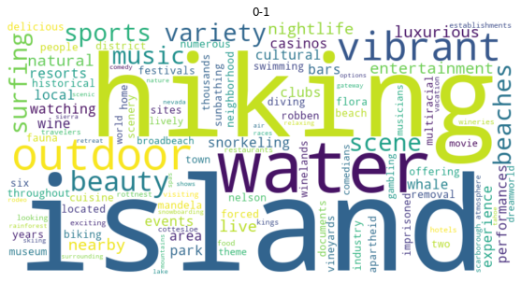
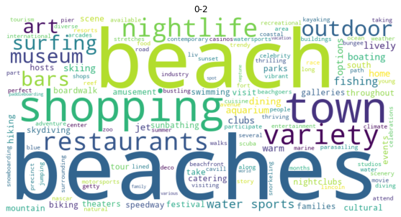
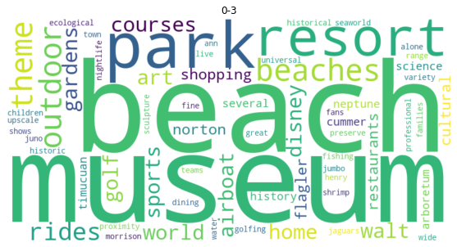
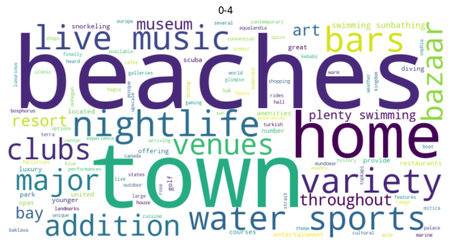
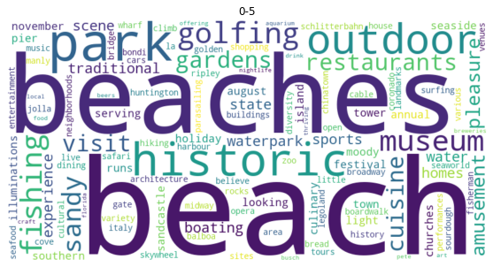
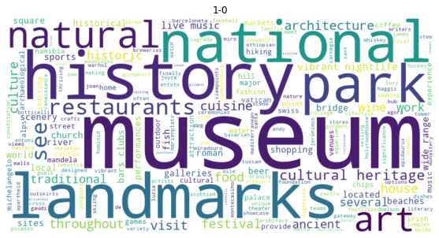
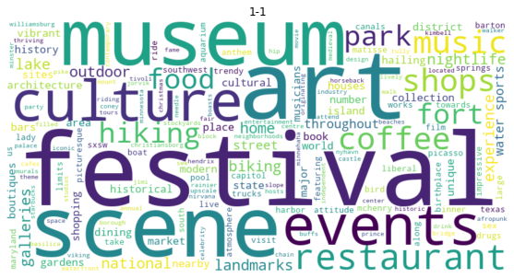
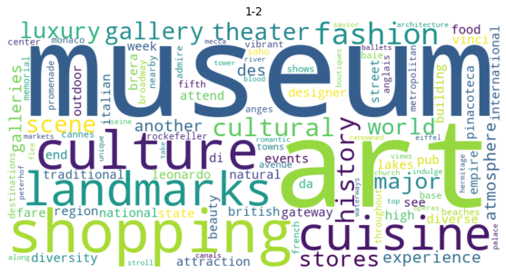
Final Results Word Clouds

Slide 21
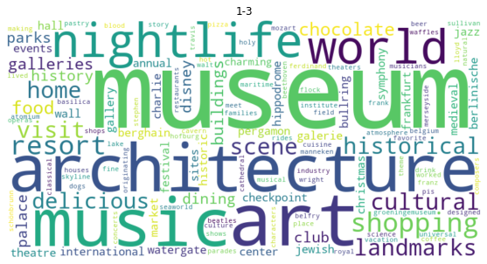
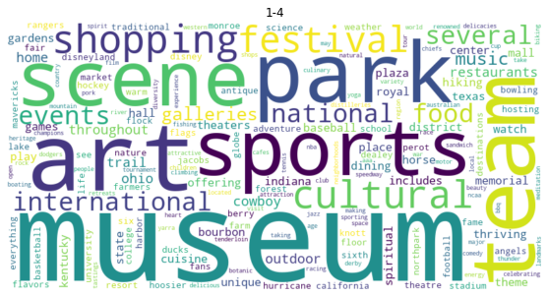
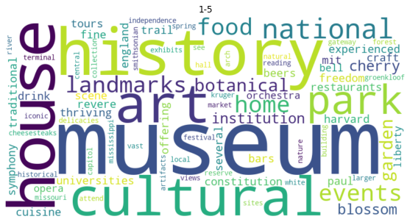
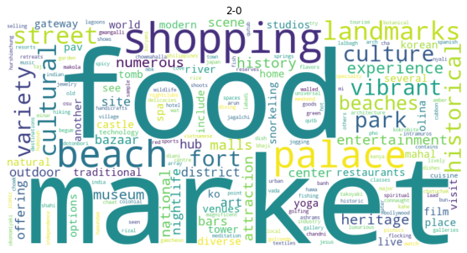
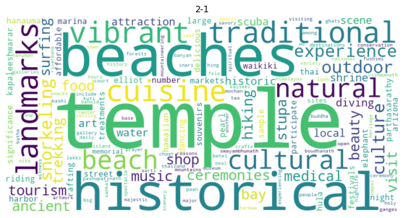
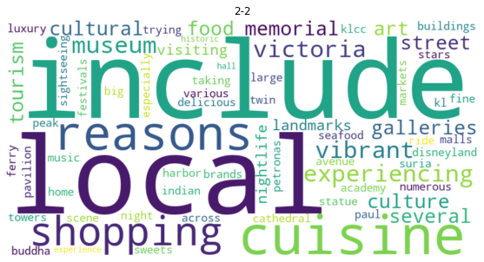
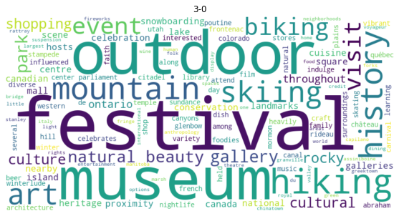
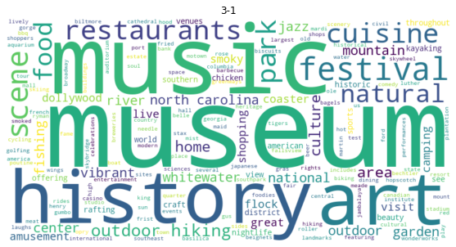
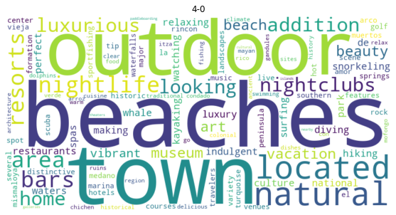
Final Results Word Clouds (Cont’d)

Slide 22
Define Final Genres
Approach 1
Based on the top 20 frequent terms in TripAdvisor text
More comprehensive and objective genres with easy to interpret key attributes
Approach 2
Based on defined numeric features
Approach 3
ChatGPT 3.0 output depending on city names

